Slide 1

Smart AI Powered Vision Glasses: Enhancing Accessibility for the Visually Impaired
Group ID: 54
Branch: ECSE
Team Members: Ananya Singh (2330288)
Pranjali Sinha (2330387)
Utkarsh Raj (2330416)
Yash Panhale (2330418)
Supervisors: Prof Tejaswini Kar
School of Electronics Engineering
KIIT Deemed to be University, Bhubaneswar

Slide 2
Objective
To design and develop a wearable assistive system for visually impaired individuals
To implement real-time object detection using the YOLOv4-Tiny algorithm
To detect nearby obstacles using ultrasonic sensors
To provide audio feedback using text-to-speech technology
To provide directional feedback using vibration motors
To ensure system functionality without internet (offline operation)
To make the system portable, efficient, and user-friendly

Slide 3
Innovation in the project
Integration of AI and embedded systems in a wearable device
Real-time object detection on Raspberry Pi
Combination of audio and vibration feedback
Offline working system without cloud dependency
Lightweight YOLOv4-Tiny model for efficiency
Glasses-based compact assistive solution

Slide 4
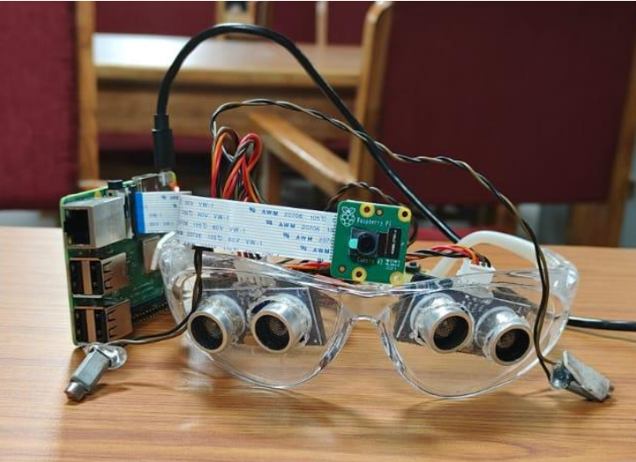
Experimental Prototype/APP Development(Images)
Camera mounted on glasses for real-time vision
Ultrasonic sensors for obstacle detection
Vibration motors for directional feedback
Raspberry Pi for processing
Earphones for audio output
Portable power supply for mobility
Complete prototype of Smart Vision Glasses

Slide 5
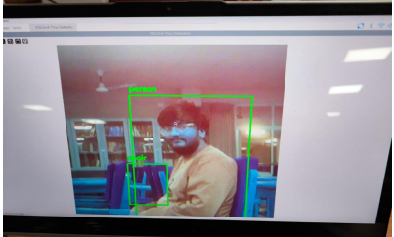
Result
Successfully detected objects like person, chair, etc.
Accurate real-time object detection achieved
Multiple objects detected with slight delay
Correct vibration feedback for left/right obstacles
System works efficiently in normal lighting
Performance reduces in low-light conditions
Object detection output using YOLO

Slide 6
Work to be Carried out
Improve detection accuracy and speed
Use advanced hardware (Raspberry Pi 4 / AI accelerator)
Enhance wearable design and comfort
Add GPS for navigation
Improve power management and battery life
Reduce audio noise and improve clarity
Add features like text recognition and voice commands

Slide 7
References(in IEEE format)
[1] J. Redmon, S. Divvala, R. Girshick, and A. Farhadi,
“YOLO: You Only Look Once: Unified, Real-Time Object Detection,”
in Proceedings of the IEEE Conference on Computer Vision and Pattern Recognition (CVPR), pp. 779–788, 2016.
[2] A. Bochkovskiy, C.-Y. Wang, and H.-Y. M. Liao,
“YOLOv4: Optimal Speed and Accuracy of Object Detection,”
arXiv preprint arXiv:2004.10934, 2020.
[3] G. Bradski,
“The OpenCV Library,”
Dr. Dobb’s Journal of Software Tools, 2000.
[4] Raspberry Pi Foundation,
“Raspberry Pi 3 Model B+ Documentation,”
[Online]. Available: https://www.raspberrypi.org
[5] Raspberry Pi Foundation,
“Picamera2 Documentation,”
[Online]. Available: https://www.raspberrypi.com
[6] GNU Project,
“eSpeak Text-to-Speech Synthesizer,”
[Online]. Available: https://espeak.sourceforge.net

